Slide 1
PYTHON TKINTER
-Yashika Sharma

Slide 2

Tkinter
Python provides the standard library Tkinter for creating the graphical user interface for desktop based applications.
It is one of the most commonly used modules for creating GUI applications in Python as it is simple and easy to work with.
Some other Python Libraries available for creating our own GUI applications are
1. Kivy
2. Python Qt
3. wxPython
Graphical User Interface(GUI)
is a form of user interface which allows users to interact with computers through visual indicators using items such as icons, menus, windows, etc. It has advantages over the Command Line Interface(CLI) where users interact with computers by writing commands using keyboard only and whose usage is more difficult than GUI.

Slide 3
Creating Main Window
Developing desktop based applications with python Tkinter is not a complex task. An empty Tkinter top-level window can be created by using the following steps.
1. import the Tkinter module.
2. Create the main application window.
3. Add the widgets like labels, buttons, frames, etc. to the window.
4. Call the main event loop so that the actions can take place on the user's computer screen.
Code:
From tkinter import *
Root=Tk()
Root.mainloop()

Slide 4
Tk()- It is used to make a main window
Mainloop()-It is an infinite loop that runs the application, waits for an event and processes it as soon as the window is open. The application window does not appear before you enter the main loop. This method says to take all the widgets and objects we created, render them on our screen, and respond to any interactions. The program stays in the loop until we close the window.
Root()- It is the name of the variable . We can give any variable name here. It is an instance of the Tkinter’s Tk() class .

Slide 5
Giving title on our window
We can also give some title to our window instead of Tk.
This can be done using the title()
CODE:
From tkinter import *
Root=Tk()
Root.title(“Program1”)
Root.Mainloop()

Slide 6
WIDGETS
There are various controls, such as buttons, labels, scrollbars, radio buttons, and text boxes used in a GUI application. These little components or controls of the Graphical User Interface (GUI) are known as widgets in Tkinter.
And it also allows us to create specialized widgets as custom widgets.

Slide 7
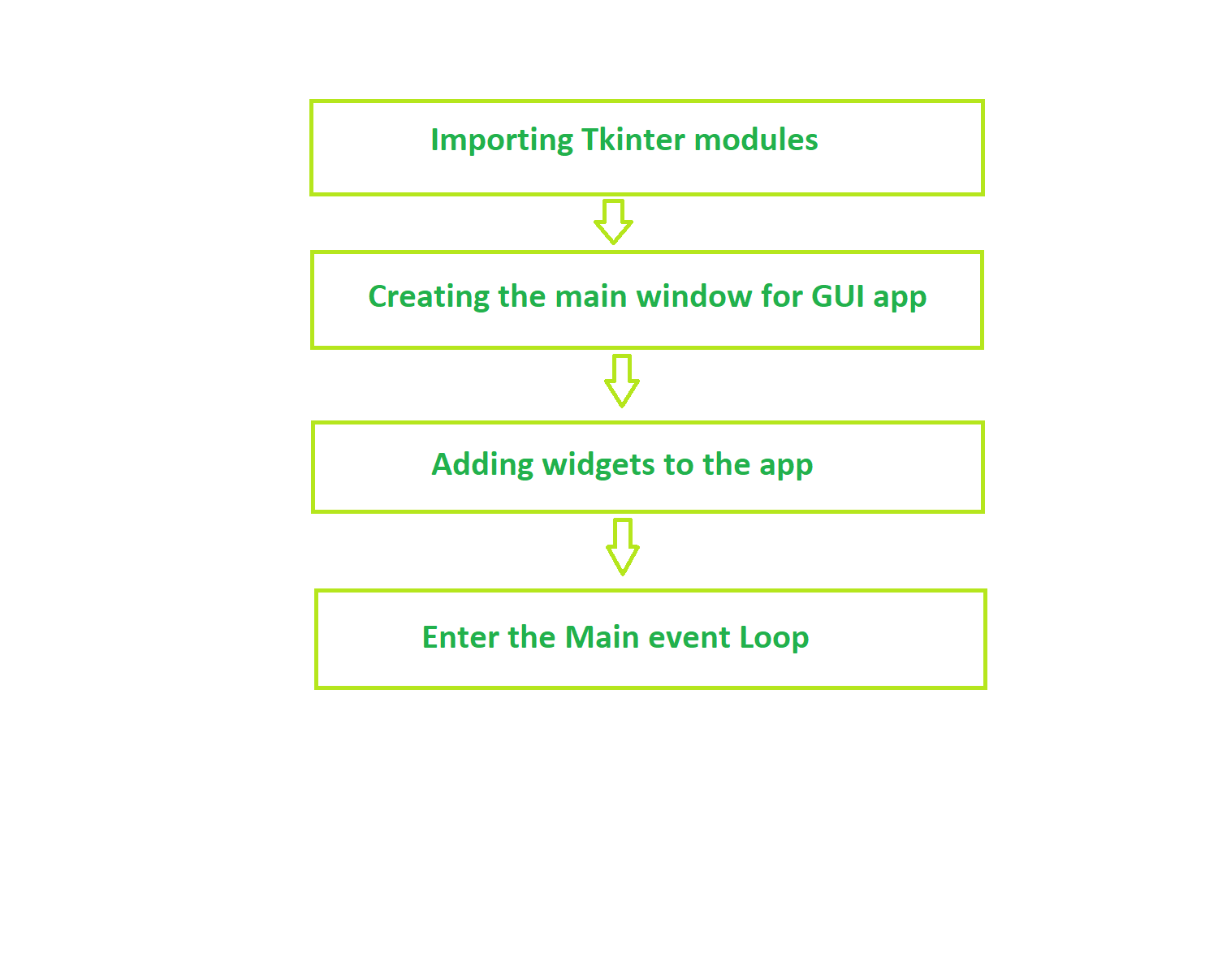
WIDGETS

Slide 8
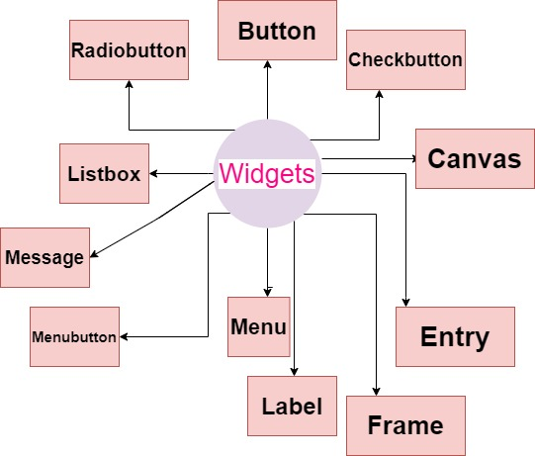
WIDGETS

Slide 9
WIDGETS- BUTTON()
The button is a widget that is used for the user to interact with just one click or a button is usually used when there is a click event in the GUI applications. The button is used to control behavior which means if we press or click the button, action or event is performed, such as displaying text or images.
SYNTAX:
Button (master, option = value)
PARAMETERS :
1. Master: This argument is used to represent or declare the root or parent window.
2. Options: There are many different values for options that are provided button widgets such as activebackground color, activeforeground color, bg, font, image, width, height, command, etc

Slide 10
WIDGETS- BUTTON()
import tkinter as tk
r = tk.Tk()
button = tk.Button(r, text='click me', width=25, command=r.destroy)
button.pack()
r.mainloop()
we have given command as r.destroy, which is used to close the root window.

Slide 11
CHECKBUTTON()
Checkbutton widget is used to display the checkbox without the checkmark and can access it through the Tkinter variable. This button usually used to store or record status like on or off, true or false, etc., which means these are also like buttons but used when the user wants to choose between two different values or status. In this, the user can select more than one checkbox.
SYNTAX:
CheckButton (master, option = value)
PARAMETERS :
Options can be like the title for giving the title to the widget, activebackground, and activeforeground for setting back and foreground color, bg for setting up the background color, command, font, image, etc.

Slide 12
CHECKBUTTON()
from tkinter import * root = Tk() v1 = IntVar() Checkbutton(root, text='Python',width =25, variable=v1).grid(row=0, sticky=S) v2 = IntVar() Checkbutton(root, text='Unix',width =25, variable=v2).grid(row=1, sticky=S) v3 = IntVar() Checkbutton(root, text='Perl',width =25, variable=v3).grid(row=2, sticky=S) mainloop()
In the above code, we have declared variables as intvar() for each option to access these checkbuttons.

Slide 13
RADIOBUTTON()
This is also similar to the checkbutton, but this widget is used when the user is given many different options but is asked to select only one among all these options. The radiobutton widgets must be associated with the same variable, and each symbolizes a single value.
SYNTAX:
CheckButton (master, option = value)
PARAMETERS :
Options are the same as for checkbuttons.

Slide 14
RADIOBUTTON()
from tkinter import *
root = Tk()
v = IntVar()
Radiobutton(root, text='male',width =25, variable=v, value=1).pack(anchor=W)
Radiobutton(root, text='female',width =25, variable=v, value=2).pack(anchor=W)
Radiobutton(root, text='others',width =25, variable=v, value=3).pack(anchor=W)
mainloop()

Slide 15
MENUBUTTON()
The Menubutton widget can be defined as the drop-down menu that is shown to the user all the time. It is used to provide the user a option to select the appropriate choice exist within the application.
The Menubutton is used to implement various types of menus in the python application. A Menu is associated with the Menubutton that can display the choices of the Menubutton when clicked by the user.
SYNTAX:
CheckButton (master, option = value)

Slide 16
Labels
Tkinter Label is a widget that is used to implement display boxes where you can place text or images.
To use a label, you just have to specify what to display in it (this can be text, a bitmap, or an image).
SYNTAX:
Label(master, option = value)
PARAMETERS:
anchor: This options is used to control the positioning of the text if the widget has more space than required for the text. The default is anchor=CENTER, which centers the text in the available space.(dot/arrow/)
bg:This option is used to set the normal background color displayed behind the label and indicator.

Slide 17
Labels
height:This option is used to set the vertical dimension of the new frame.
width:Width of the label in characters (not pixels!). If this option is not set, the label will be sized to fit its contents.
bd:This option is used to set the size of the border around the indicator. Default bd value is set on 2 pixels.
font:If you are displaying text in the label (with the text or textvariable option), the font option is used to specify in what font that text in the label will be displayed.

Slide 18
Labels
cursor:It is used to specify what cursor to show when the mouse is moved over the label. The default is to use the standard cursor.
textvariable: As the name suggests it is associated with a Tkinter variable (usually a StringVar) with the label. If the variable is changed, the label text is updated.
bitmap:It is used to set the bitmap to the graphical object specified so that, the label can represent the graphics instead of text.
fg:The label color, used for text and bitmap labels. The default is system specific. If you are displaying a bitmap, this is the color that will appear at the position of the 1-bits in the bitmap.

Slide 19
Labels
image: This option is used to display a static image in the label widget.
padx:This option is used to add extra spaces between left and right of the text within the label.The default value for this option is 1.
pady:This option is used to add extra spaces between top and bottom of the text within the label.The default value for this option is 1.
justify:This option is used to define how to align multiple lines of text. Use LEFT, RIGHT, or CENTER as its values. Note that to position the text inside the widget, use the anchor option. Default value for justify is CENTER.
relief: This option is used to specify appearance of a decorative border around the label. The default value for this option is FLAT.

Slide 20
Labels
wraplength
You can limit the number of characters in each line by setting this option to the desired number. The default value, 0, means that lines will be broken only at newlines.
underline:
You can display an underline (_) below the nth letter of the text, counting from 0, by setting this option to n. The default is underline = -1, which means no underlining.

Slide 21
Displaying Hello World!
For displaying any text on the window we use label()

Slide 22
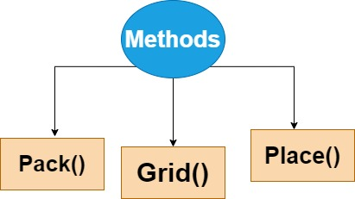
Geometry manager classes
In order to organize or arrange or place all the widgets in the parent window, Tkinter provides us the geometric configuration of the widgets. The GUI Application Layout is mainly controlled by Geometric Managers of Tkinter.

Slide 23
pack()
The pack() method mainly uses a packing algorithm in order to place widgets in a Frame or window in a specified order.
This method is mainly used to organize the widgets in a block.
It is used to place widget on the top.
PACKING ALGORITHM:
The steps of Packing algorithm are as follows:
1. Firstly this algorithm will compute a rectangular area known as a Parcel which is tall (or wide) enough to hold the widget and then it will fill the remaining width (or height) in the window with blank space.
2. It will center the widget until any different location is specified.
This method is powerful but it is difficult to visualize.
Here is the syntax for using pack() function:
widget.pack(options)

Slide 24
pack()
The possible options as a parameter to this method are given below:
Fill: The default value of this option is set to NONE. Also, we can set it to X or Y in order to determine whether the widget contains any extra space.
Side: This option specifies which side to pack the widget against. If you want to pack widgets vertically, use TOP which is the default value. If you want to pack widgets horizontally, use LEFT.
Expand: This option is used to specify whether the widgets should be expanded to fill any extra space in the geometry master or not. Its default value is false. If it is false then the widget is not expanded otherwise widget expands to fill extra space.

Slide 25
Pack()
import tkinter as tk
win = tk.Tk()
frame1 = tk.Frame(master=win, width=100, height=100, bg="orange")
frame1.pack()
frame2 = tk.Frame(master=win, width=50, height=50, bg="blue")
frame2.pack()
frame3 = tk.Frame(master=win, width=25, height=25, bg="green")
frame3.pack()
window.mainloop()

Slide 26
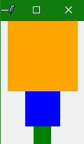
Pack()

Slide 27
grid()
The most used geometry manager is grid() because it provides all the power of pack() function but in an easier and maintainable way.
The grid() geometry manager is mainly used to split either a window or frame into rows and columns.
You can easily specify the location of a widget just by calling grid() function and passing the row and column indices to the row and column keyword arguments, respectively.
Index of both the row and column starts from 0, so a row index of 2 and a column index of 2 tells the grid() function to place a widget in the third column of the third row(0 is first, 1 is second and 2 means third).

Slide 28
grid()
Here is the syntax of the grid() function:
widget.grid(options)
The possible options as a parameter to this method are given below:
Column
This option specifies the column number in which the widget is to be placed. The index of leftmost column is 0.
Row
This option specifies the row number in which the widget is to be placed. The topmost row is represented by 0.
Columnspan
This option specifies the width of the widget. It mainly represents the number of columns up to which, the column is expanded.

Slide 29
grid()
Rowspan
This option specifies the height of the widget. It mainly represents the number of rows up to which, the row is expanded.
Sticky
If any cell is larger than a widget, then sticky is mainly used to specify the position of the widget inside the cell. It is basically concatenation of the sticky letters which represents the position of the widget. It may be N, E, W, S, NE, NW, NS, EW, ES.

Slide 30
place()
The place() Geometry Manager organizes the widgets to place them in a specific position as directed by the programmer.
This method basically organizes the widget in accordance with its x and y coordinates. Both x and y coordinates are in pixels.
Thus the origin (where x and y are both 0) is the top-left corner of the Frame or the window.
Thus, the y argument specifies the number of pixels of space from the top of the window, to place the widget, and the x argument specifies the number of pixels from the left of the window.
Here is the syntax of the place() method:
widget.place(options)

Slide 31
place()
The possible options as a parameter to this method are given below:
x, y
This option indicates the horizontal and vertical offset in the pixels.
height, width
This option indicates the height and weight of the widget in the pixels.
Anchor
This option mainly represents the exact position of the widget within the container. The default value (direction) is NW that is (the upper left corner).
bordermode
This option indicates the default value of the border type which is INSIDE and it also refers to ignore the parent's inside the border. The other option is OUTSIDE.

